Slide 1

DeepCellType: Refining Bulk Data with Deep Learning
Juan Irizarry-Cole

Slide 2
The Problem
“Bulk” biological data contains mixtures of numerous cell types.
Modern sequencing and expression analysis techniques are capable of single cell resolution.
Differential gene expression across cell types confounds usefulness of conclusions reached with bulk data.
Mountains of data remain convoluted within that bulk data

Slide 3
The Goal
Use a machine learning approach to automatically classify different coarse grain cell types.
Extracting a clear image from convoluted data requires a deconvolution approach
Robust deconvolution models already exist for images
The DREAM challenge specified 8 cell types to be labeled
Target Cell Types
Fibroblasts
B Cells
Endothelial Cells
NK Cells
Neutrophils
Myeloid Lineage Cells
CD4+ Cells
CD8 T Cells

Slide 4
The Caveats
Whereas image data is usually structured by pixel distance, allowing convolutional approaches to work, microarray data is not
Possible future solutions: force the data indices to conform to actual genomic order
Likewise, microarray data is not time series data so they are not easily fed properly into a recurrent neural network
The Multilayer Perceptron is always available to us
However, an MLP can only do so much with data…

Slide 5
The Data (Oh brother)
However, several problems exist with the data
Labels are extracted from reports automatically using regex, which may cause incorrect labeling of certain samples
The samples use different probe sets with different indices
Many of the samples are outside the 8 detected classes or ambiguously labeled
Even within the same probe sets, the length of the probe lists differ.
Even within probe sets of the same lengths, the indices are reordered.
Some samples simply don’t exist
Cumulative Data Subset | Sample Size | Percentage of total
Total | 49,320 | 100%
Data that exist and use the [HG-U133_Plus_2] Affymetrix Human Genome U133 Plus 2.0 Array probe set and which fall into one of the 8 listed cell types | 9,400 | 19.1%
Data that exists with length 54,675 | 7,607 | 15.4%

Slide 6
Data Sparseness
7,607 samples is small for a complex network such as the genome
Without a defined order to the data, only a few deep learning model archetypes are easily usable
Is it even possible to train a model on a subset of this subset?

Slide 7
Yes.

Slide 8
Consistent Ordering
Throwing random numbers won’t work
The order can be arbitrary as long as it is consistent
Using Python’s Pandas package, one sample’s index can act as the standard index across all samples of the same length.
Maximum length may be unnecessary; future testing can involve minimal index and cross-platform sorting.
Remember: the main goal is to see if a model can learn at all.

Slide 9


Finally, the Model
DeepCellType
Element-wise Affine Normalization
Input Layer Size (Variable): 54,675
Hidden Layer 1 Size: 6,400
Leaky ReLU Dropout
Hidden Layer 2 Size: 1280
Leaky ReLU Dropout
Output Layer Size: 8
Leaky ReLU Dropout
Softmax

Slide 10
Training Attributes and Info
Attribute | Info
Model Parameters | 35,932,718
Loss Function | Cross Entropy Loss
Optimizer | ADAM
Learning Rate | 0.001
Dropout Probability | 0.7
Epochs | 100
Train/Test Ratio | 0.9:0.1
Batch Size | 50

Slide 11
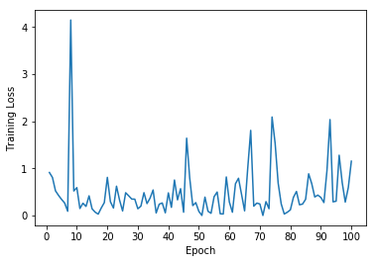
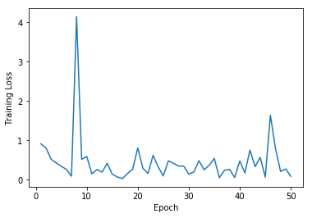
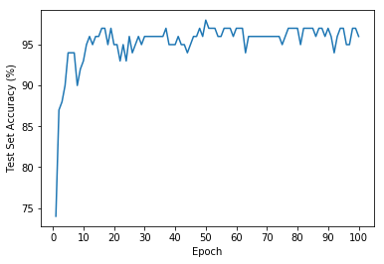
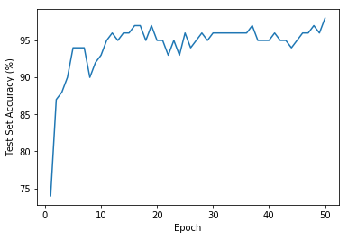
Training Results
Loss over 100 Epochs
Loss over 50 Epochs
Accuracy over 100 Epochs
Accuracy over 50 Epochs
Peak Test Set Accuracy: 98%

Slide 12
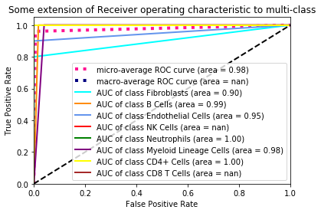
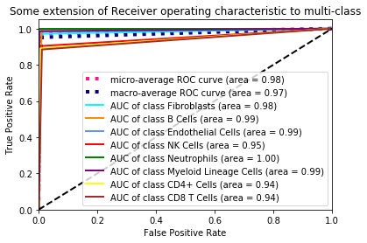
The Moment of Truth
Area Under the Curve on 5% of the Training Set
Area Under the Curve on the Full Training Set

Slide 13
Conclusions, Discussions, and Next Steps
A simple deep learning model is capable of learning deep connections in microarray data to predict broad stroke cell types with high confidence.
Fine grain cell types may require more data and a more robust model. Reordering the data by genomic position may allow convolutions to improve results.
Normalizing the data and implementing dropout layers made for drastically better results
The data loader can be tweaked to give a more universally usable model using the Entrez gene IDs to standardize probe sets across many platforms and sample sizes.
Additionally, the model can easily be adapted to bulk RNA-Seq data.

Slide 14
Thank you!
Questions?

